Slide 1
Dots and Boxes
Artificial Intelligence Project
Syed Muhammad Hussain-26992
Sahil Kumar

Slide 2
Introduction to Dots and Boxes

Slide 3
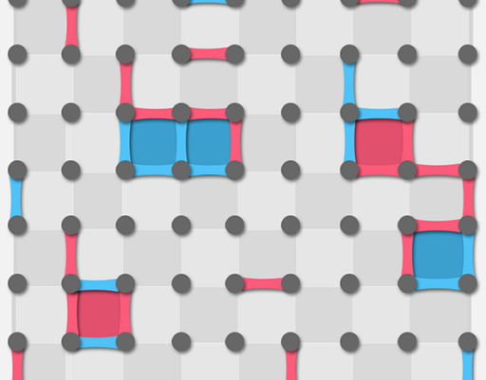
What is Dots and Boxes?
Dots and Boxes is a classic pencil-and-paper game that is easy to learn but can involve complex strategies.
The main objective of the game is to form more boxes than your opponent by connecting dots on a grid.

Slide 4
Game Mechanics
Gameplay:
Players take turns connecting two adjacent dots with a horizontal or vertical line.
If a player completes the fourth side of a box, they earn a point and take another turn.
Winning:
The game ends when all possible lines have been drawn.
The player with the most completed boxes wins.
Turns:
Each player alternates turns unless they complete a box, which allows for an additional move.
Strategy:
Players must balance between creating opportunities for themselves and blocking their opponent.

Slide 5
Project Goal

Slide 6
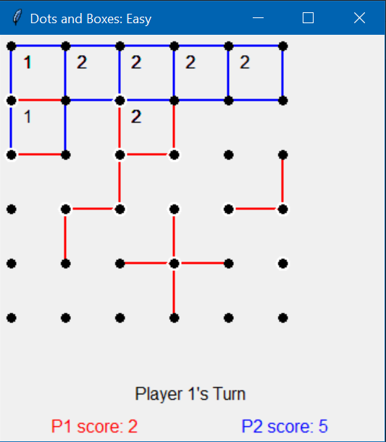
Objective
Develop an AI capable of playing Dots and Boxes against a human player with the aim of providing a challenging and engaging experience.

Slide 7
Why Dots and Boxes?
Simplicity with Depth:
While the rules are simple, the game offers a wide range of strategic depth, making it an ideal candidate for showcasing AI capabilities.
Educational Value:
Dots and Boxes serves as an excellent platform for understanding and demonstrating fundamental concepts in game theory, decision-making, and AI strategy.

Slide 8
Project Scope
AI Development:
Designing and implementing an AI that can play Dots and Boxes at varying levels of difficulty.
User Interface:
Creating an interactive interface where users can play against the AI.
Performance Evaluation:
Testing the AI against human players to assess its performance and refine its strategies.

Slide 9
AI Techniques Used

Slide 10
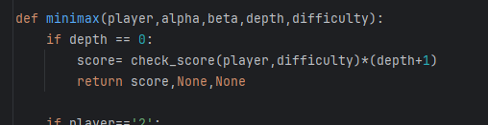
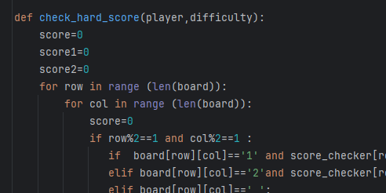
Algorithms and Approaches
Minimax Algorithm with Alpha-Beta Pruning:
-Dots and Boxes is a 2 player turn taking game, so minimax was well suited for this game..
-Used Alpha-beta pruning to increase the speed of the algorithm.
- We combined the minimax with evaluation function called check_score(). (details of this function in the report)

Slide 11
Why These Techniques?
Effective for strategic decision-making.
Balance between computational efficiency and game performance.

Slide 12
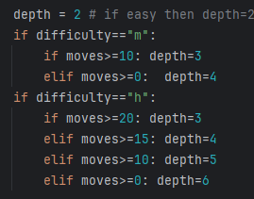
Different Difficulty Levels
Change in depth? How?
-For easy difficulty, the search depth is only 2.
-For medium difficulty, search depth starts with 3 and increases gradually.
-For hard difficulty, search depth starts at 3 and increases more than medium.

Slide 13
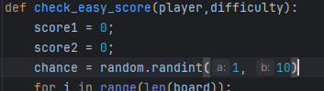
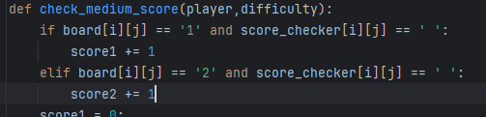

Difficulty level (continued)
Different evaluation functions for each difficulty.
Easy mode: inject randomness, 70% of the time Ai makes bad move and 30% of the time it makes good move.
Medium mode: counts the number of boxes made by each player and returns the score
Hard mode: combines the medium mode with 1 additional thing: checks how many coordinates have 3 or 2 lines around them (potential boxes/points for the future ) and assigns score according to that.

Slide 14
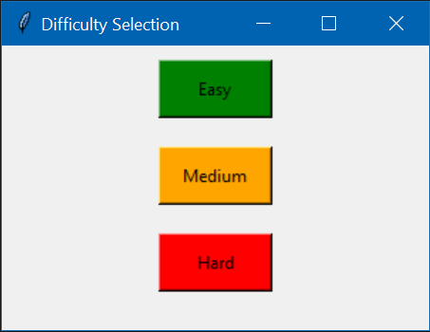
Key Features of the AI
-Real-time Decision Making
-Quick and efficient move calculation: for easy and medium difficulty it hardly takes a second.
-For hard difficulty it might take 2-3 seconds towards the end of the game (when search depth is increased)
-You can select the difficulty level:
-If you are beginner, you can select easy mode.
-If you are looking for a competition, you can select hard mode.

Slide 15
Conclusion

Slide 16
Summary of Achievements
AI Development:
Successfully designed and implemented an AI capable of playing Dots and Boxes at multiple difficulty levels.
Algorithm Optimization:
Applied advanced algorithms such as Minimax with Alpha-Beta Pruning to ensure efficient and effective decision-making.
User Interface:
Created a user-friendly interface that allows seamless interaction between the human player and the AI.
Testing and Evaluation:
Conducted extensive testing with human players to evaluate the AI’s performance and make necessary adjustments.

Slide 17
Potential Improvements
Improvement Areas:
Continue to refine the AI’s strategies to handle more complex scenarios and higher levels of difficulty.
Advanced Techniques:
Explore the integration of machine learning techniques to enhance the AI’s adaptive capabilities.
Multiple Users:
Enhance the game to allow multiple players to play with the Computer instead of just one player.

Slide 18
Demonstration

